Slide 1
MATHEMATICAL ANALYSIS OF RECURSIVE AND NON RECURSIVE ALGORITHM
Mathematical Analysis of Algorithms
Mathematical analysis evaluates an algorithm’s efficiency using:
Time Complexity – number of basic operations as a function of input size n
Space Complexity – memory used as a function of n
We express results using asymptotic notation:
Big-O (O) – upper bound (worst case)
Theta (Θ) – tight bound
Omega (Ω) – lower bound

Slide 2
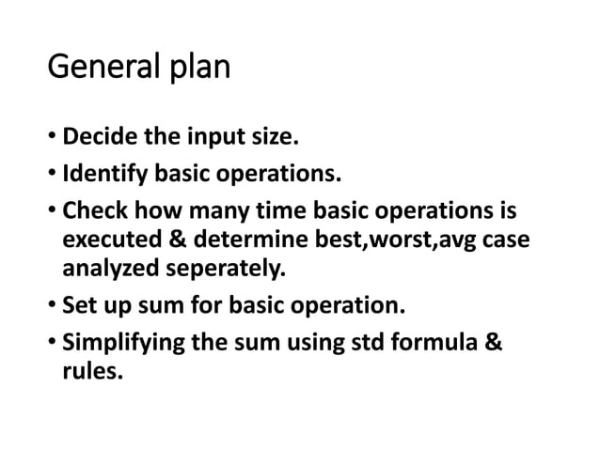

Slide 3
Example 1: Single Loop
for i = 1 to n
x = x + 1
Number of operations = n
Time Complexity: Θ(n)
Example 2: Nested Loop
for i = 1 to n
for j = 1 to n
x = x + 1
Number of operations = n²
Time Complexity: Θ(n²)
Space Complexity
Uses fixed number of variables
No function stack
Space Complexity: Θ(1)

Slide 4
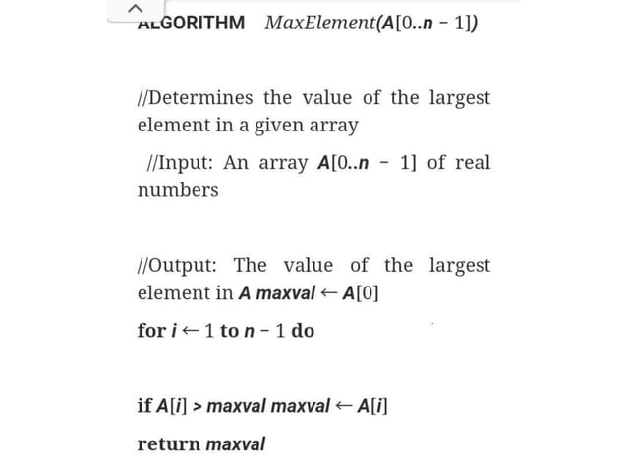

Slide 5
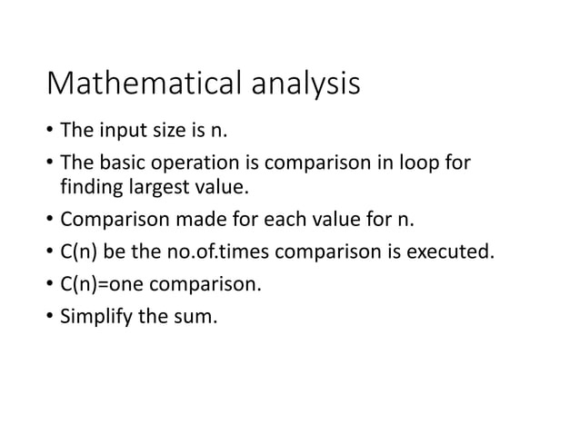

Slide 6
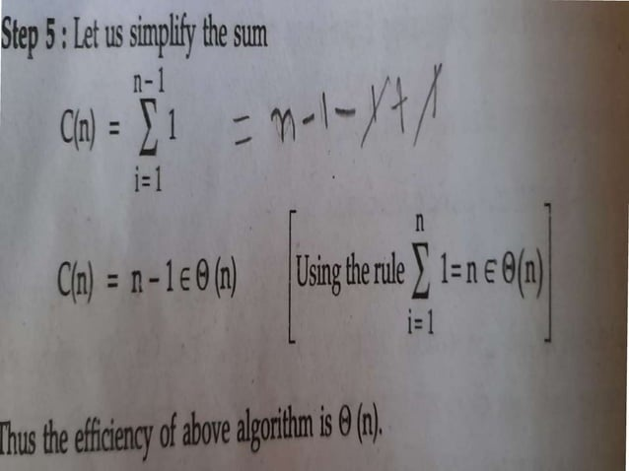

Slide 7
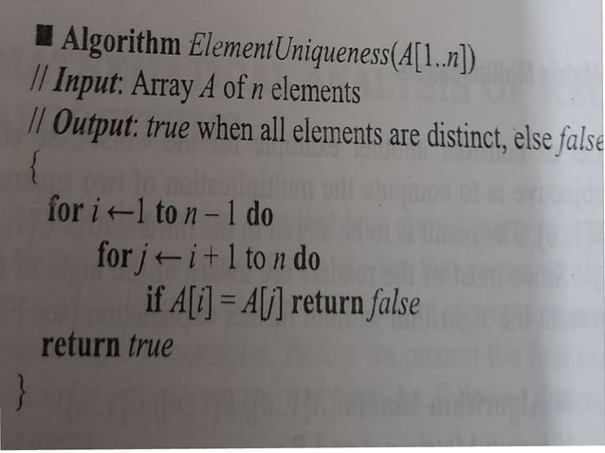

Slide 8
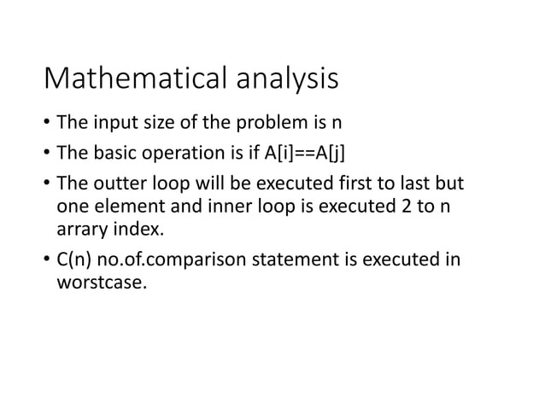

Slide 9
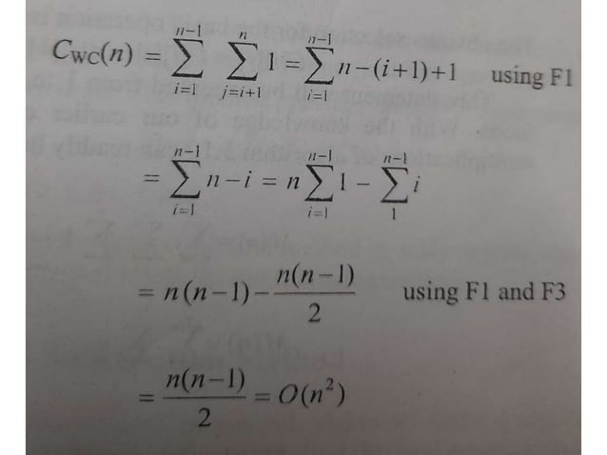

Slide 10
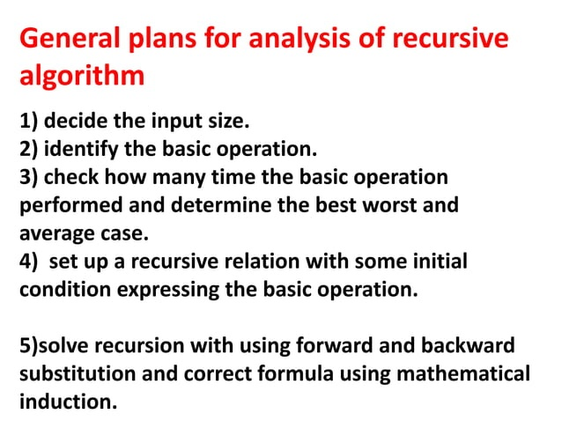

Slide 11
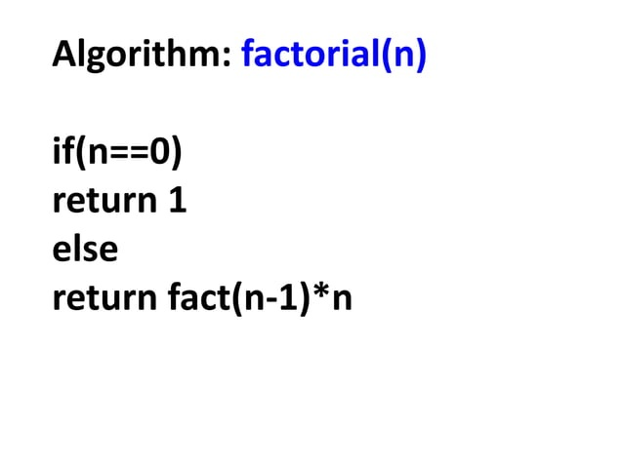

Slide 12
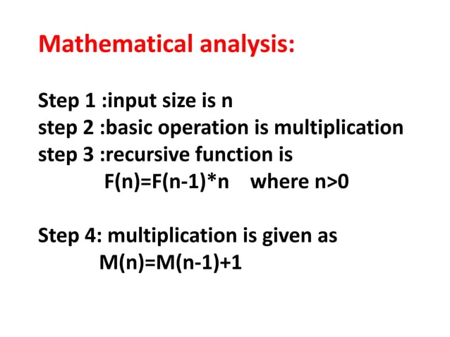

Slide 13
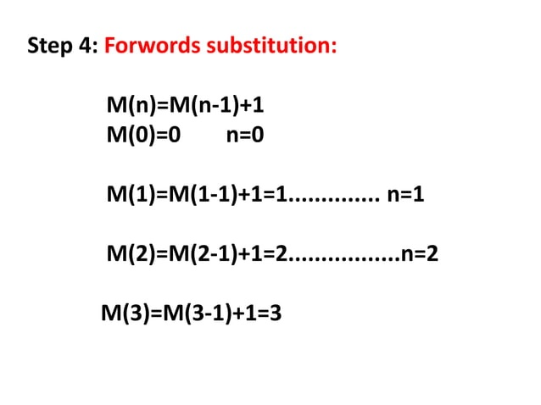

Slide 14
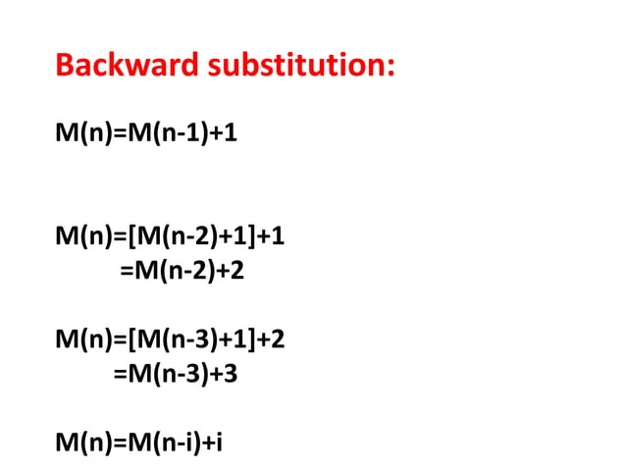

Slide 15
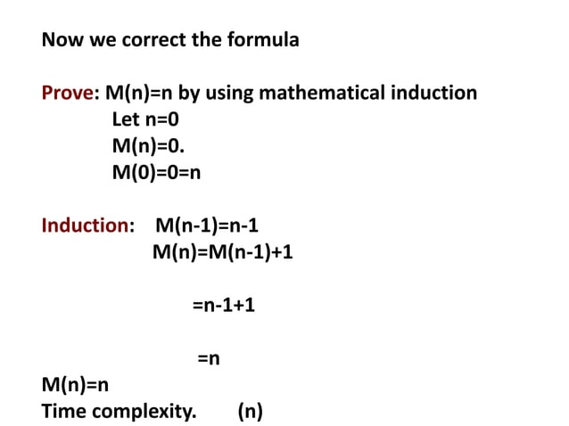

Slide 16


